Slide 1

How to run a bar with Azure Service Bus

Slide 2




Who is Jerry?
Active since 2006
Technical Consultant .NET Solutions @ Inetum-Realdolmen
Technical Lead DevOps-Team Zanzibar
Visit bars, beer, festivals, The Simpsons fan, …
jerry.vanechelpoel@inetum-realdolmen.world
@qlurichaun
www.linkedin.com/in/jerryvanechelpoel

Slide 3

Why this session?
Covid-19
Missing Cloudbrew
Learn Azure Service Bus basics
I was thirsty
➔ Create my own bar simulator with
.NET 5
Azure

Slide 4

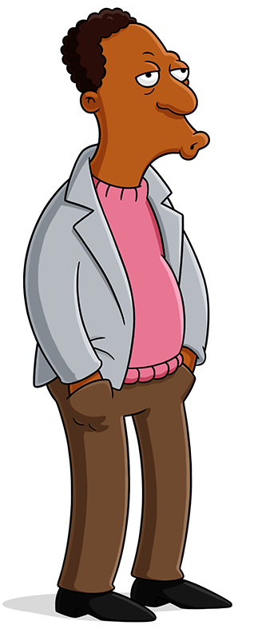
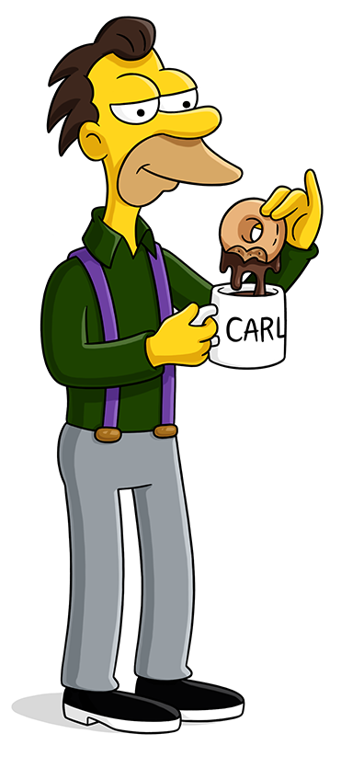


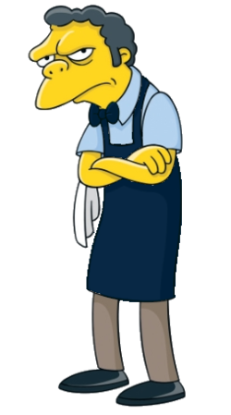
Partners in crime

Slide 5
What is Azure Service Bus?

Slide 6
Azure Service Bus
Fully managed enterprise integration message broker
Decouples different applications from each other
Reliable and secure platform for asynchronous transfer of data and state
➔ Allows applications to communicate without having a direct impact on each other

Slide 7
Why should you run a bar with Azure Service Bus?

Slide 8
People have better things to do than waiting
Waiters
Take orders
Serve drinks
Do dishes
Taking a break
Customers
Playing cards
Talk to friends
Stare at their future ex
➔ Optimize resource usage

Slide 9
Waiters can do only one thing at a time
Busy bar = longer waiting times
Maximum capacity beer tap
Human intervention
Barrel needs to be changed
Get special beers from basement
➔ Throttling

Slide 10
Trustworthy bar service
Orders
Should not be forgotten
No skipping in the line
Drinks
Should be served
to the correct person
➔ Reliable communication

Slide 11
Azure Service Bus Bar Requirements

Slide 12
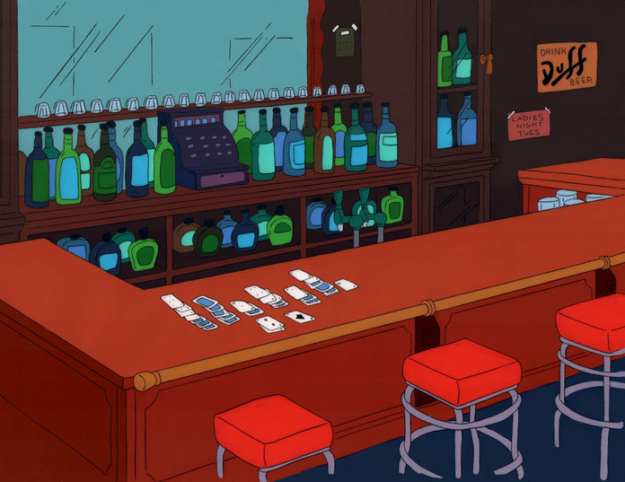
Infrastructure in the pub
Hardware
Bar
Chairs
➔ Namespace

Slide 13
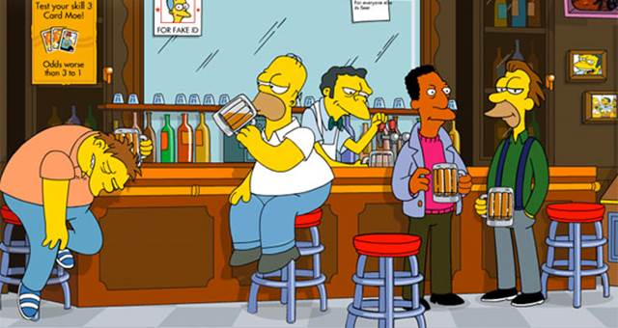
Pub rules
Orders
Are made at the bar
Waiters handle an order at a time
Nobody should be skipped
Drinks
Are served on the bar
People receive the drinks with their name on
If you don’t sit at the bar, you don’t get served

Slide 14
Pub rules → Messaging components
Orders & drinks
Ordering process
FIFO processing
Bar
Drinks are served on the bar
Chair at the bar
Customers take drinks ordered on their name
Messages
Queue
Topic
Subscription
Rule

Slide 15
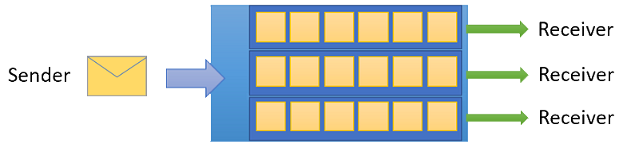

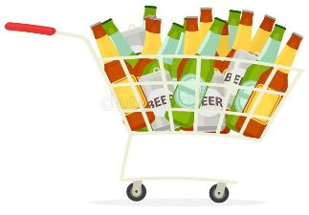

Queues, Topics & Subscriptions
Queues
Reliable messaging
1 message, 1 consumer
Messages are
sent to a queue
received from a queue
➔ Load balancer semantics
Topics & subscriptions
Don’t guarantee delivery
1 message, multiple consumers
Messages are
sent to a topic
received from a subscription if the filter applies
➔ Publish & subscribe semantics

Slide 16
Subscription rules
Define whether a subscriber is interested
Each matching filter produces a copy of the message
Filter conditions
Boolean filters
TrueFilter or FalseFilter
→ Default filter = TrueFilter
SQL filters
SQL-like conditional expression on user-defined and system properties
Correlation filters
Set of conditions matched against an arriving message's user and system properties
➔ Filters evaluate against message properties, not to the message body!

Slide 17
Reliable communication

Slide 18
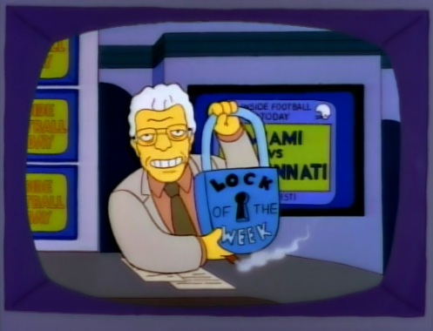
Getting the next order or drink ➔ Retrieval modes
Peek & Lock
Locked on retrieval
Complete or abandon
Autocomplete
Remove when processed

Slide 19
Retries
Retry every X time
Linear
Wait longer after each retry
Exponential
Retries
Retries
Time
Time

Slide 20

Handling malicious orders and spoiled drinks
Can’t be processed
Deadletter queue (DLQ)
Manually
Automatic after predefined amount of attempts

Slide 21
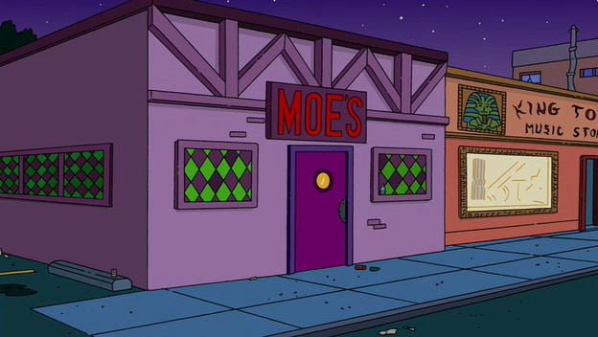
Enough talking, let’s create our own bar!

Slide 22
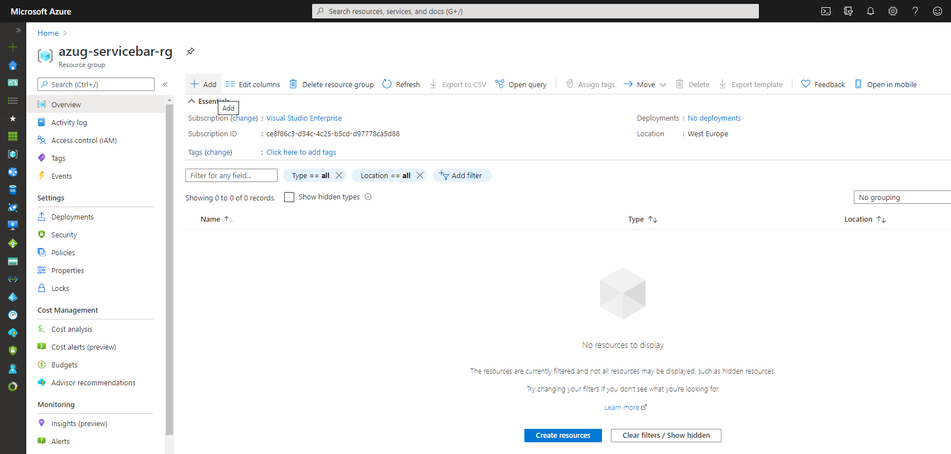

Slide 23
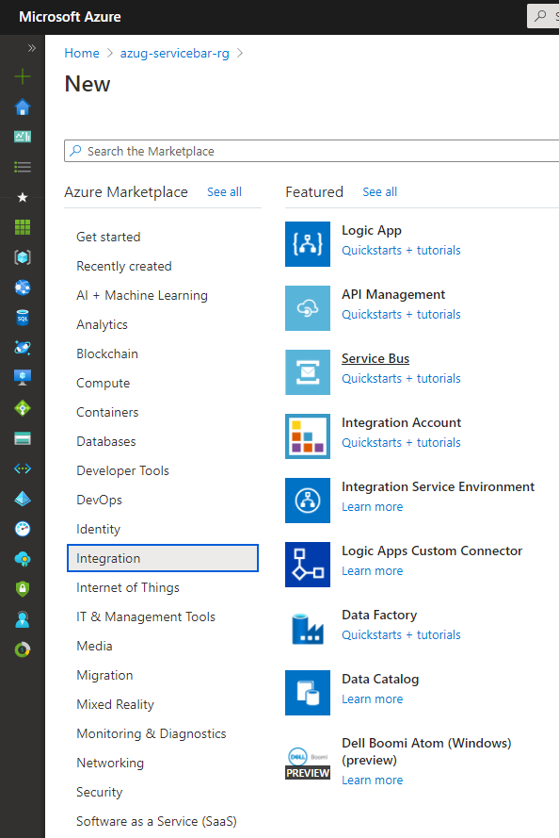

Slide 24
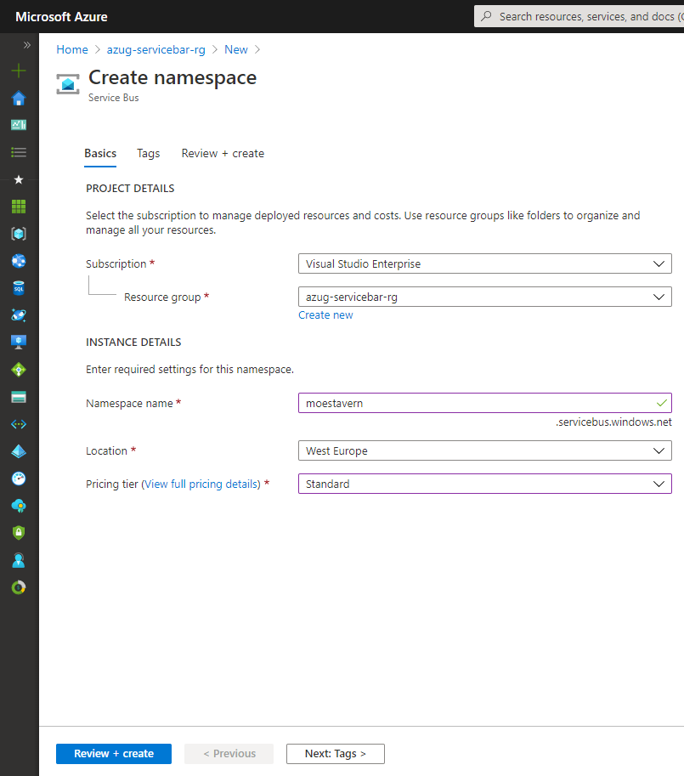
Notes:
Standard is at least required to get support for topics & subscriptions

Slide 25
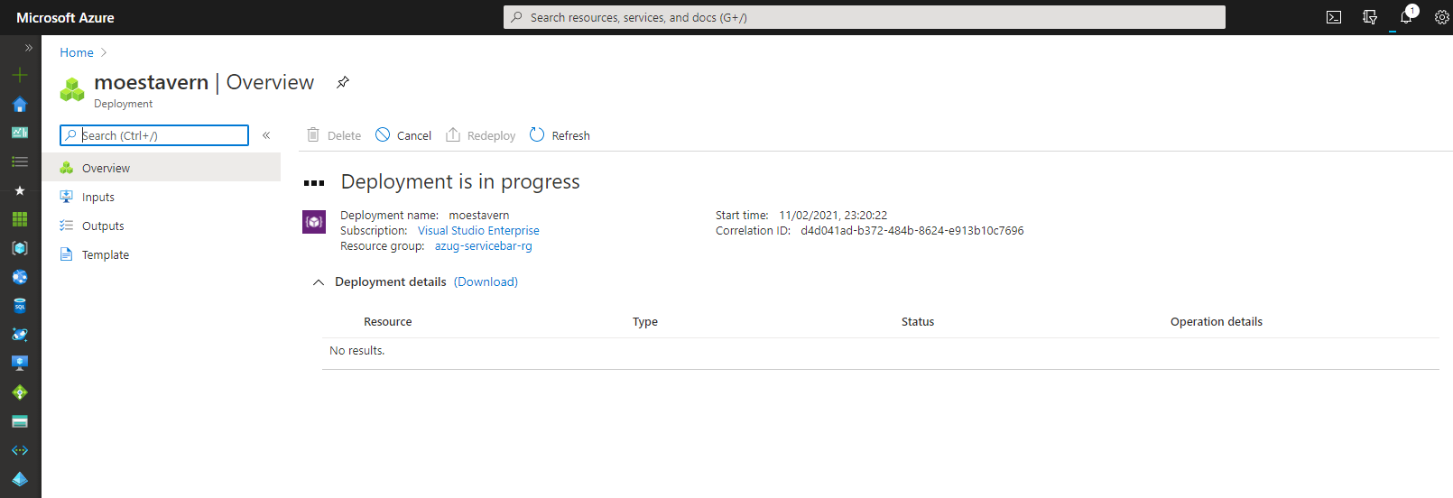

Slide 26
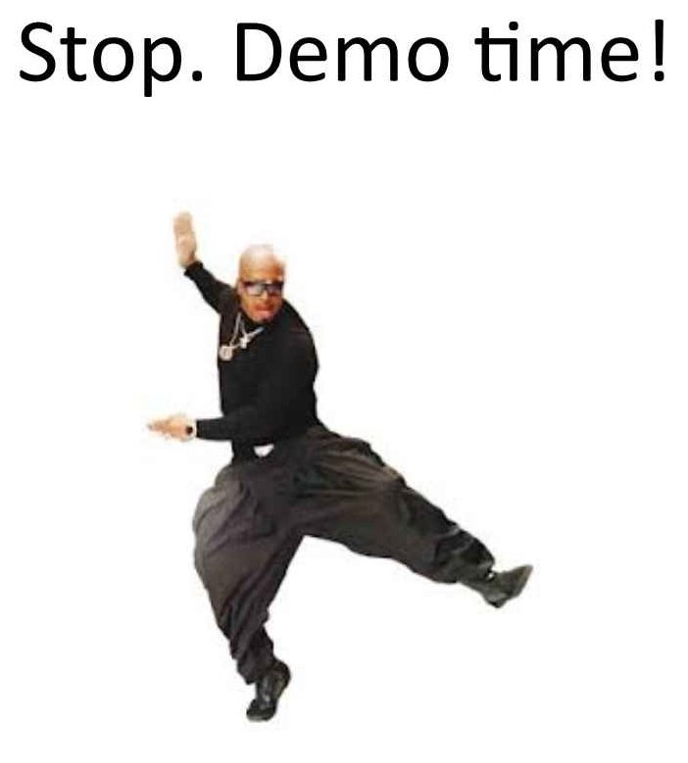

Slide 27
Useful material
Code
jerryvanechelpoel/howtorunabarwithazureservicebus
Microsoft Docs
Azure Service Bus messaging overview - Azure Service Bus | Microsoft Docs
Nuget
NuGet Gallery | Microsoft.Azure.ServiceBus 5.1.1
NuGet Gallery | Microsoft.Azure.Management.ServiceBus 2.1.0

Slide 28


